Slide 1
Core APIs: gRPC, GraphQL or HATEOAS - what's a dev to do?
Dave Lewis
Lead Developer at iSAMS
Twitter: welshdave
Email: dave@dllewis.org

Slide 2
Life used to be so simple

Slide 3
Life used to be so simple
.NET Remoting

Slide 4
Life used to be so simple
.NET Remoting
XML Web Services

Slide 5
Life used to be so simple
.NET Remoting
XML Web Services
WCF

Slide 6
Life used to be so simple
.NET Remoting
XML Web Services
WCF
ASP.NET Web API

Slide 7

And then this happened

Slide 8
NET Remoting

Slide 9
NET Remoting
XML Web Services

Slide 10
NET Remoting
XML Web Services
WCF

Slide 11
NET Remoting
XML Web Services
WCF
ASP.Net Web API

Slide 12
So we just build a REST API using Web API, right?

Slide 13
So we just build a REST API using Web API, right?
I am getting frustrated by the number of people calling any HTTP-based interface a REST API.
Roy Fielding
https://roy.gbiv.com/untangled/2008/rest-apis-must-be-hypertext-driven

Slide 14
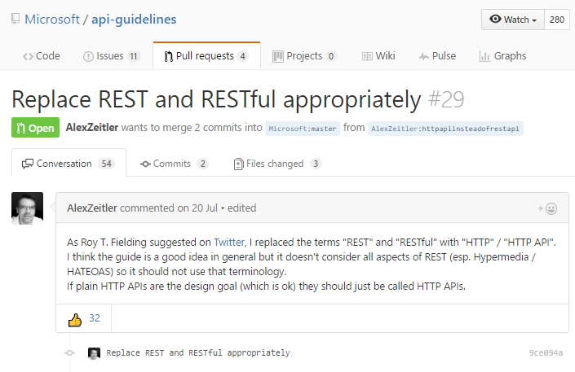
Even with the best of intentions, we just end up building systems that use JSON over HTTP APIs

Slide 15
This is a common mistake by folks who were formerly deep in the Web Services world: to describe REST as some sort of HTTP version of a SOAP/RPC interface.
Roy Fielding
https://www.infoq.com/news/2016/07/microsoft-rest-api

Slide 16
So, what are the options?

Slide 17

So, what are the options?

Slide 18

So, what are the options?

Slide 19





So, what are the options?

Slide 20
Built on top of HTTP/2

Slide 21
Built on top of HTTP/2
Uses protocol buffers for serialization

Slide 22
Built on top of HTTP/2
Uses protocol buffers for serialization
Clients use a stub to make calls to the server

Slide 23
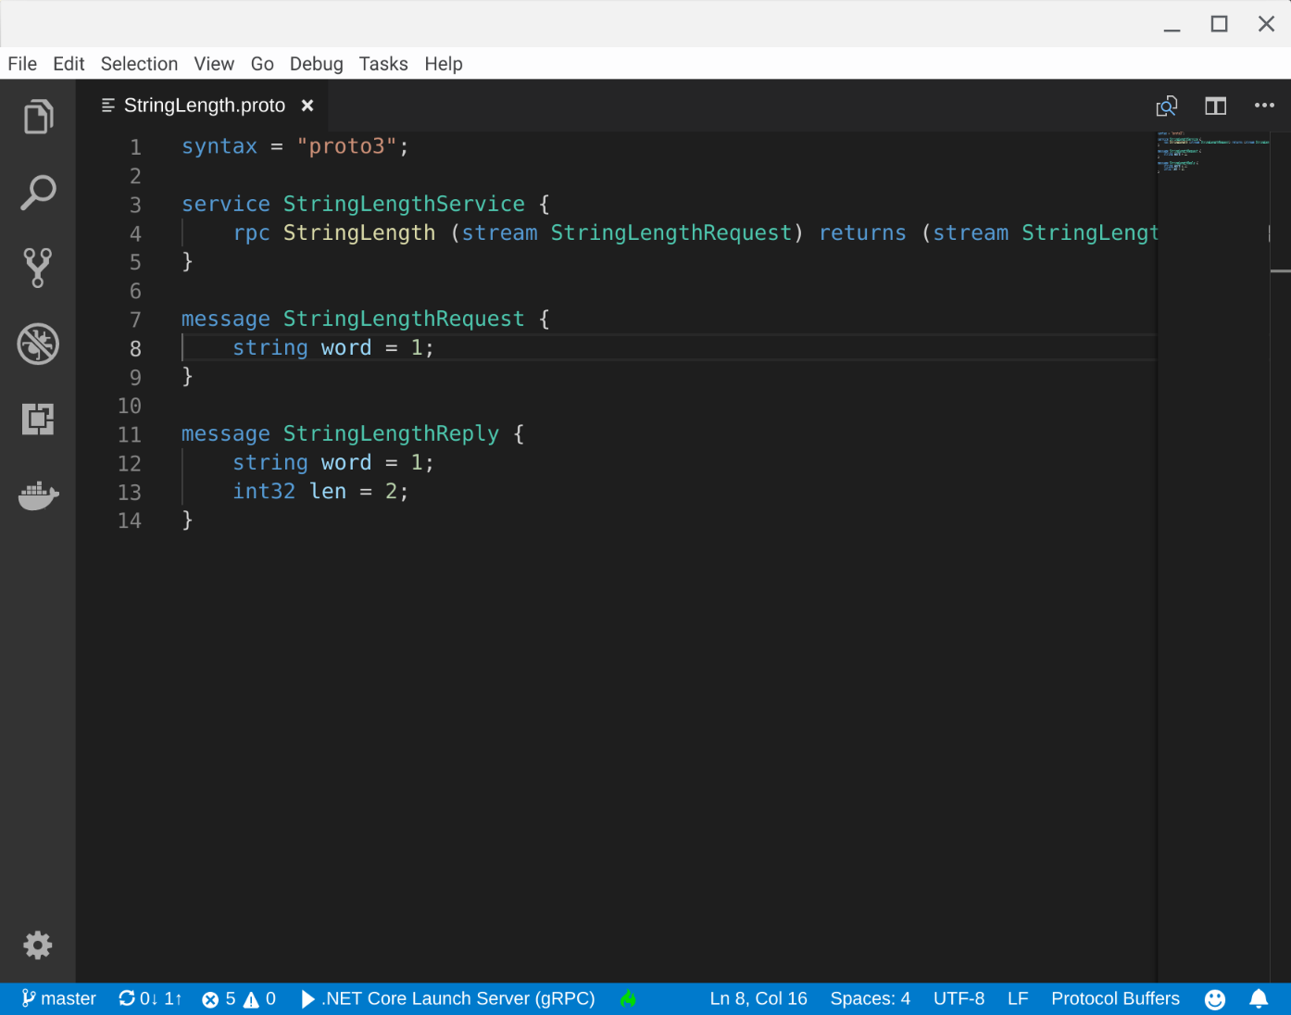

Slide 24
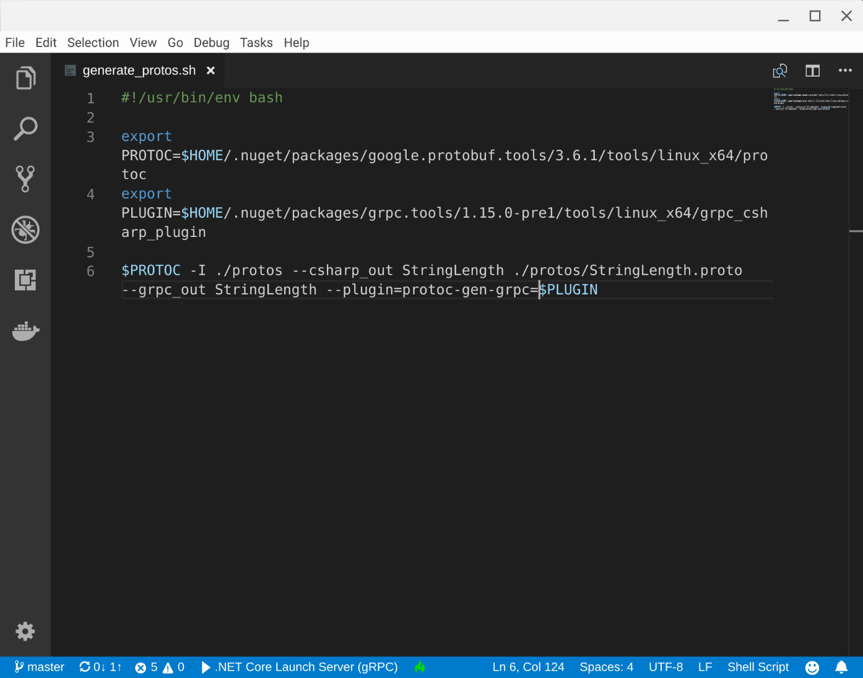

Slide 25
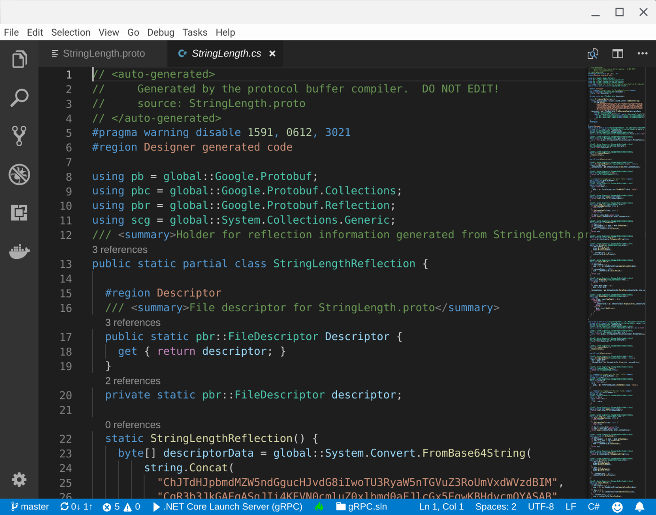

Slide 26
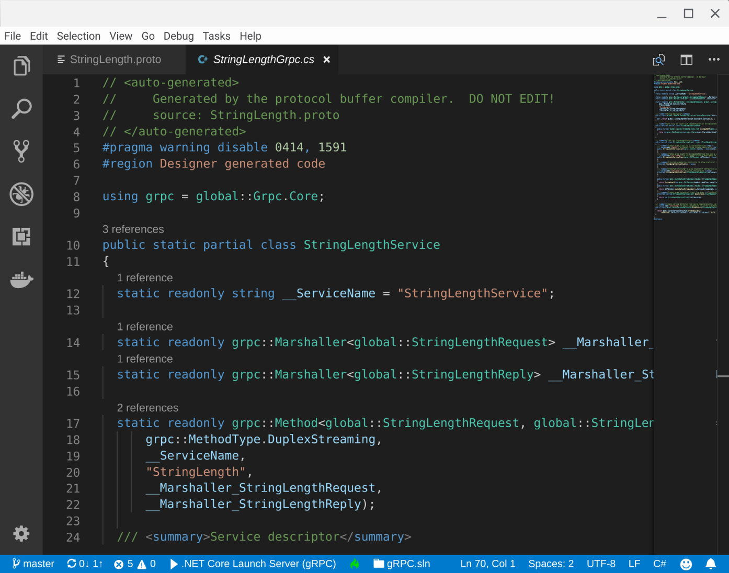

Slide 28
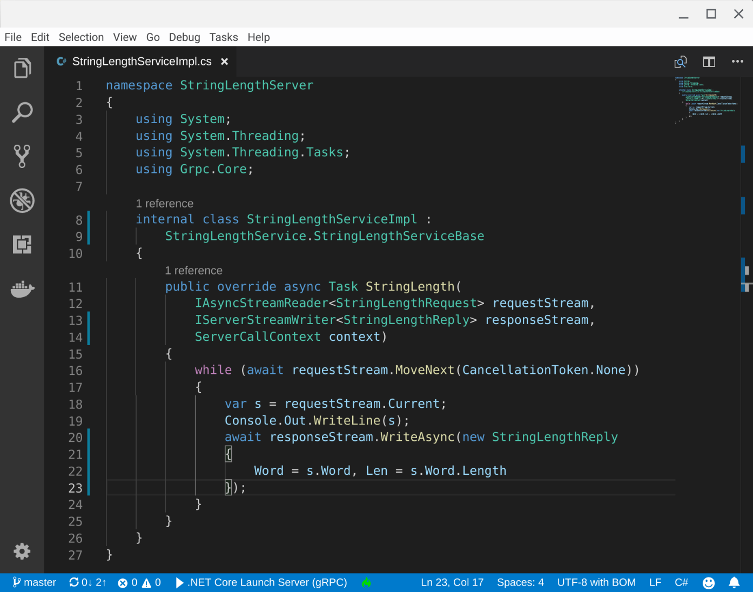

Slide 29
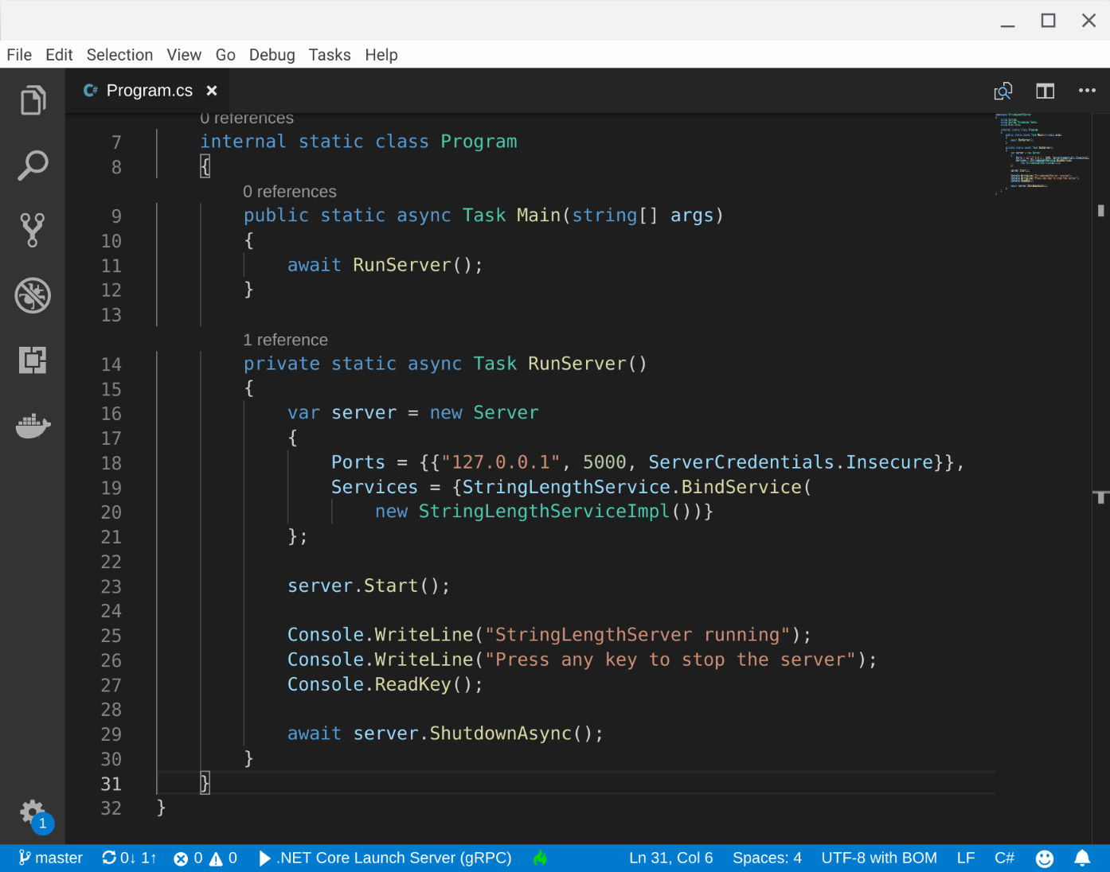

Slide 30
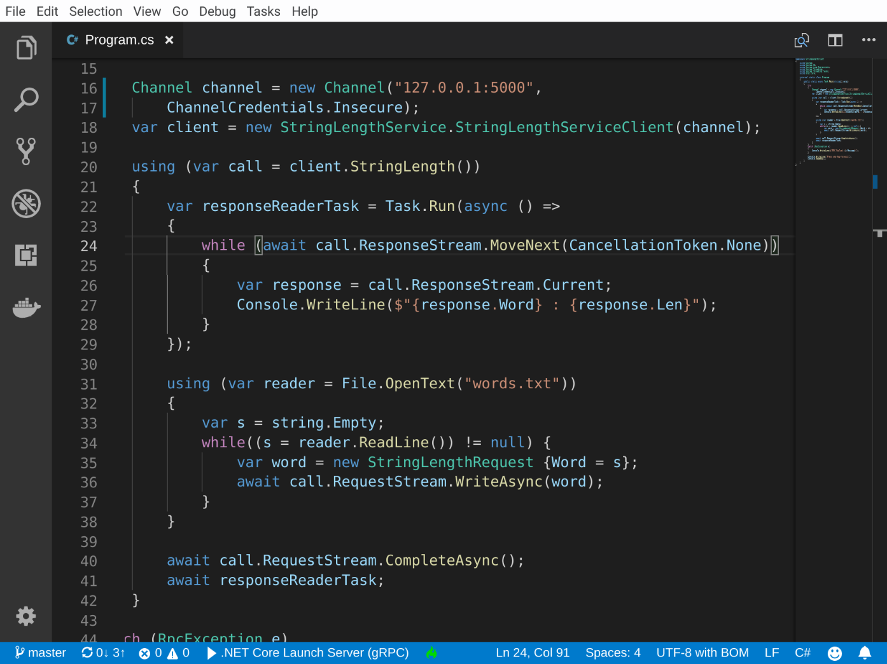

Slide 31
Ideal for internal services

Slide 32
Ideal for internal services
Users are using an SDK you provide

Slide 33
Ideal for internal services
Users are using an SDK you provide
It’s not so great for the web

Slide 34
Ideal for internal services
Users are using an SDK you provide
It’s not so great for the web
Tooling not so mature

Slide 35
Links:
https://grpc.io/
https://github.com/grpc/grpc-web
https://github.com/grpc-ecosystem/grpc-gateway
https://github.com/jnewmano/grpc-json-proxy
https://www.envoyproxy.io/
https://www.nginx.com/blog/nginx-1-13-10-grpc/

Slide 36
Normally operates over HTTP

Slide 37
Normally operates over HTTP
Provides a way of querying your existing data

Slide 38
Normally operates over HTTP
Provides a way of querying your existing data
Better query efficiency

Slide 39
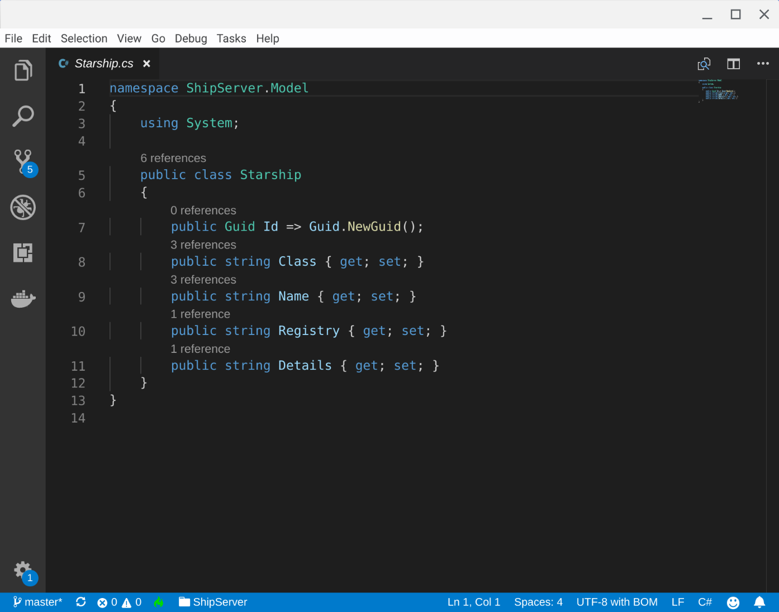

Slide 40
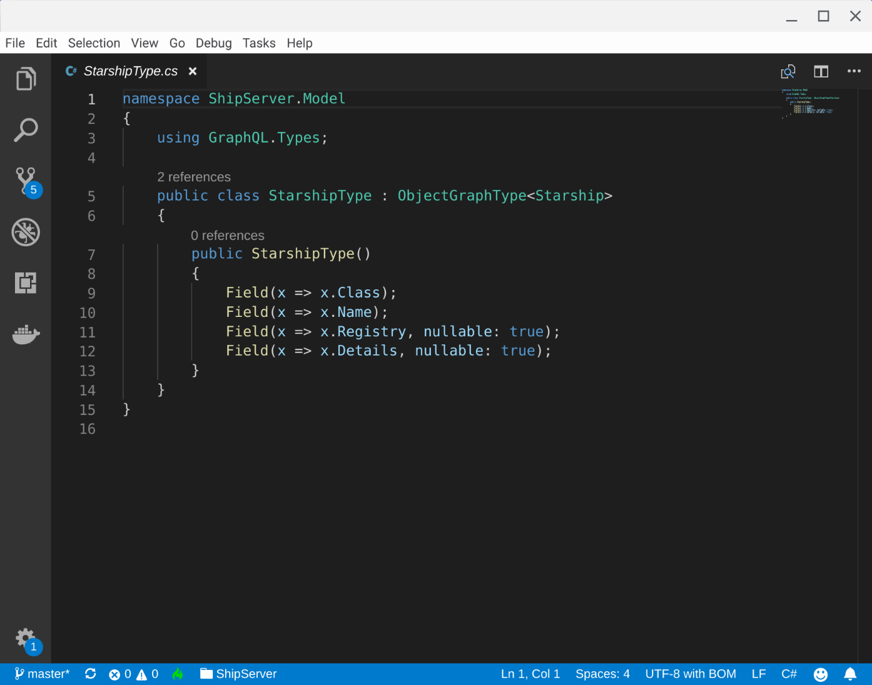

Slide 41
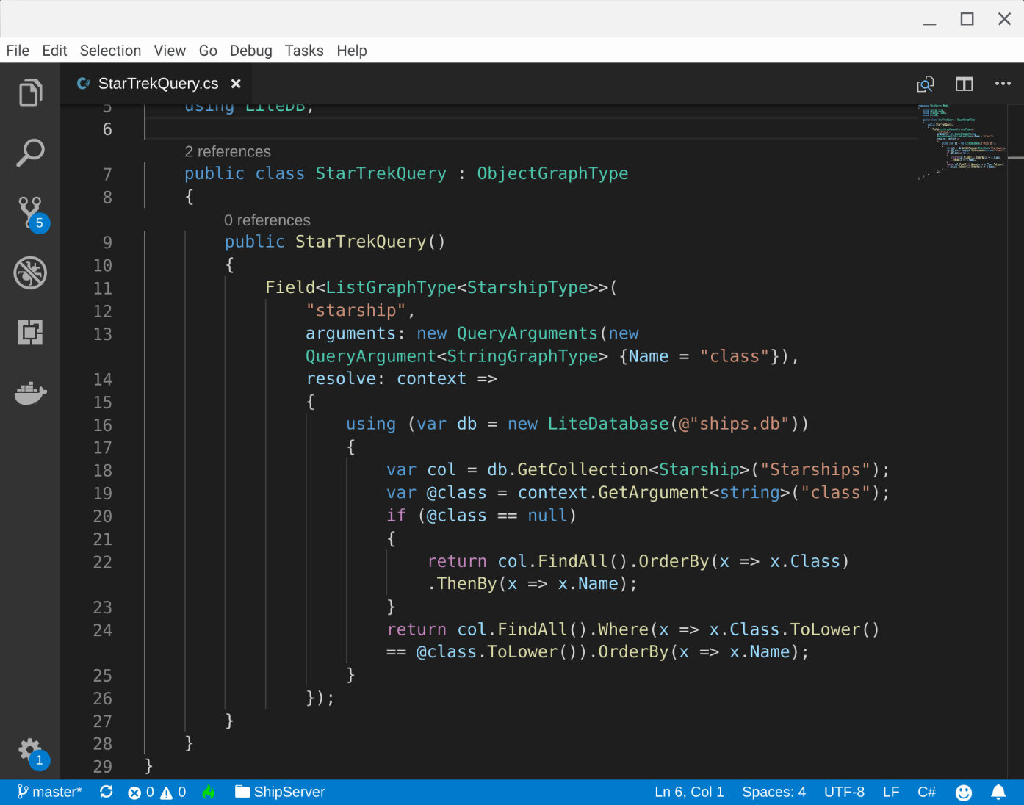

Slide 42
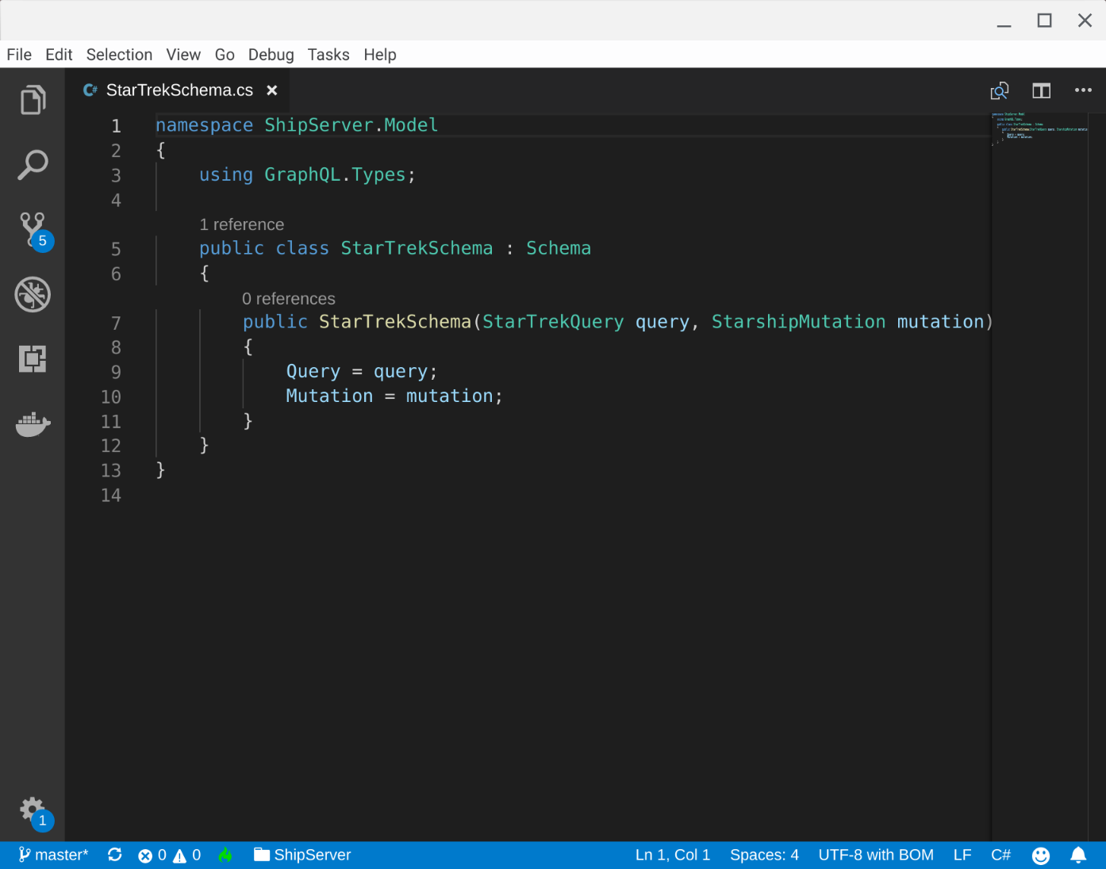

Slide 43
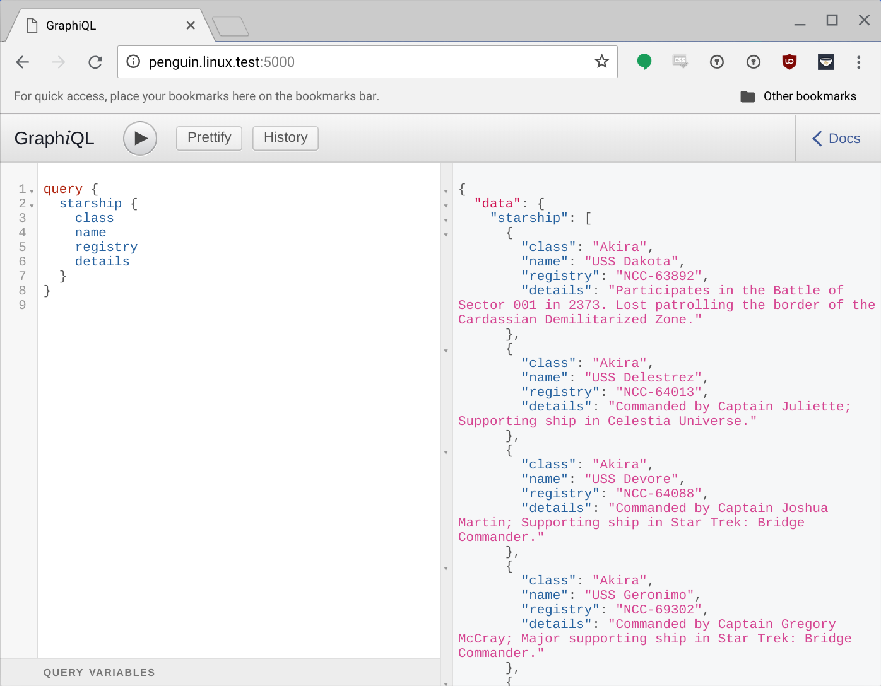

Slide 44
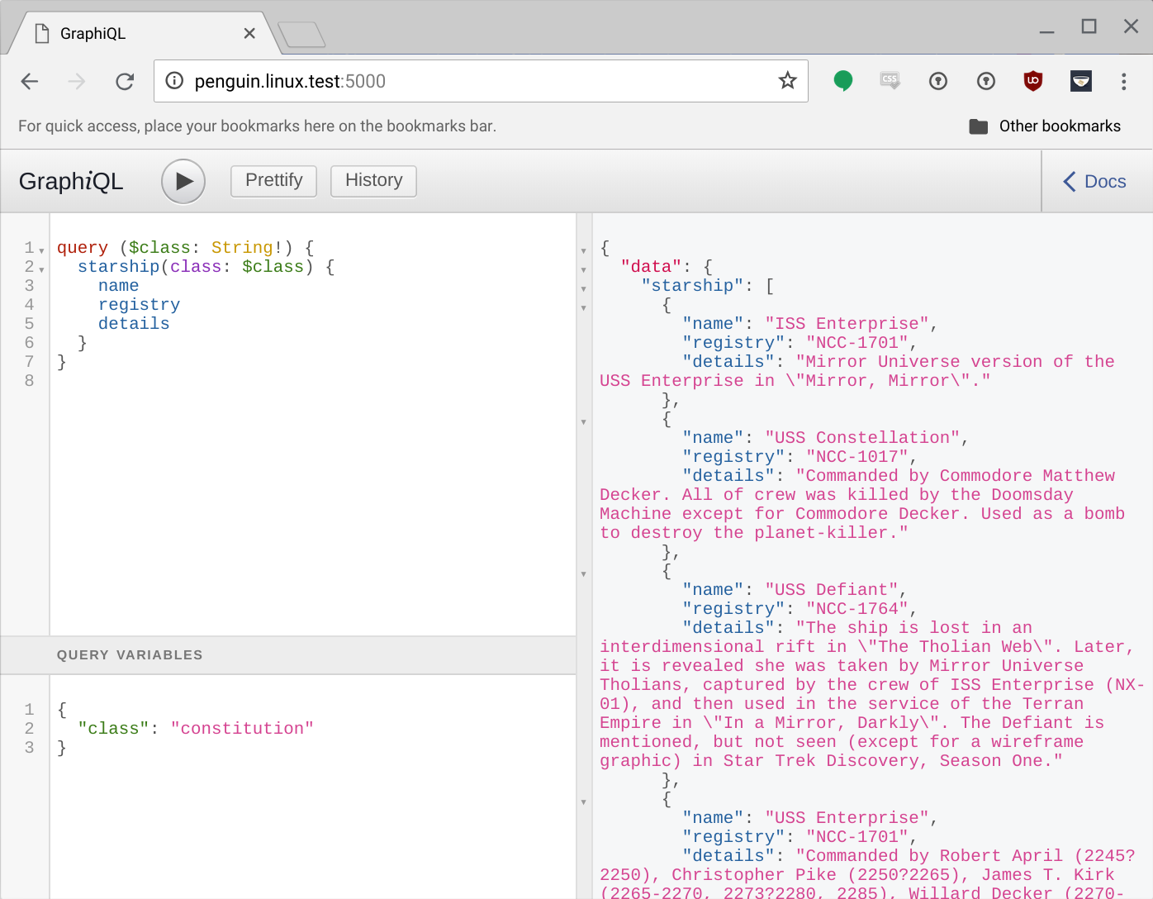

Slide 45
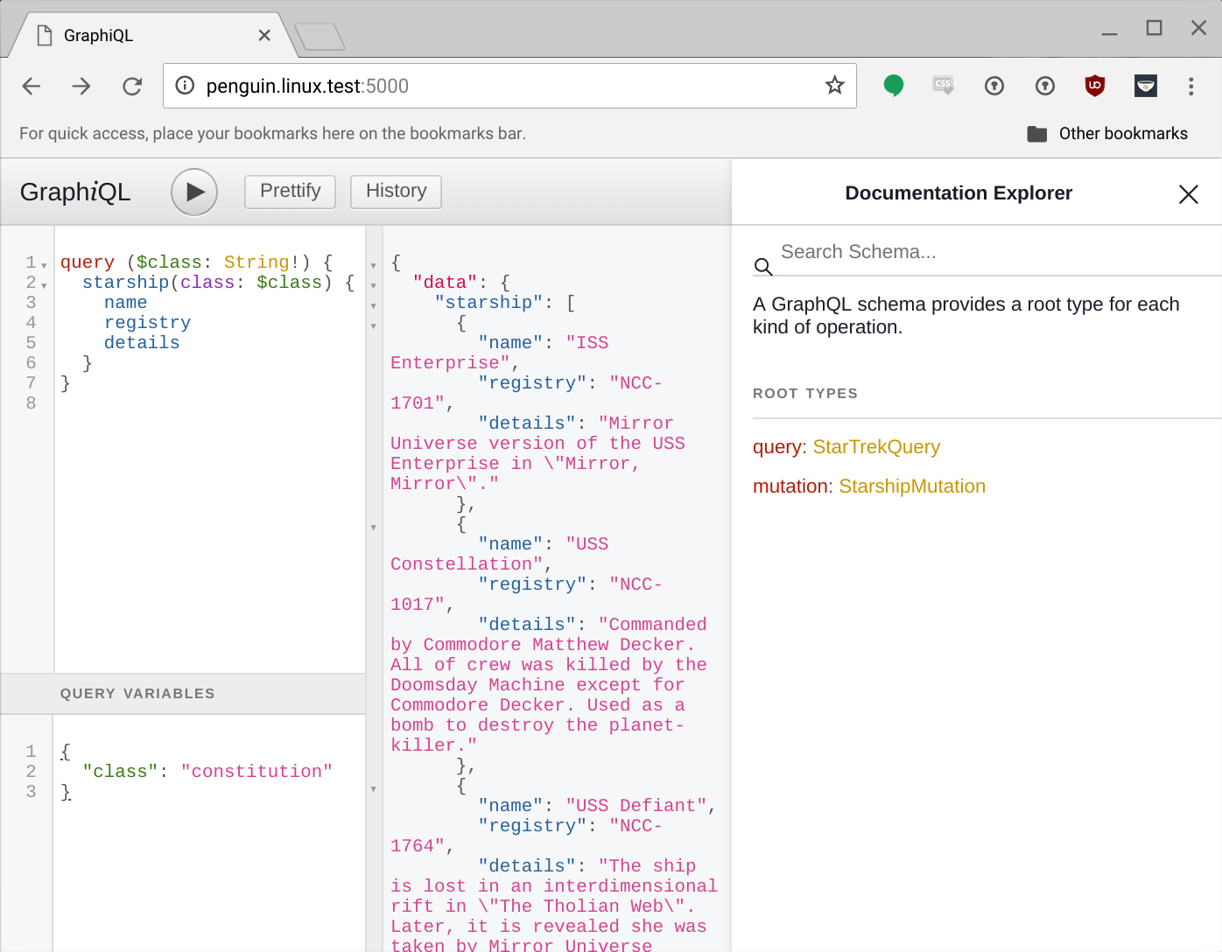

Slide 46
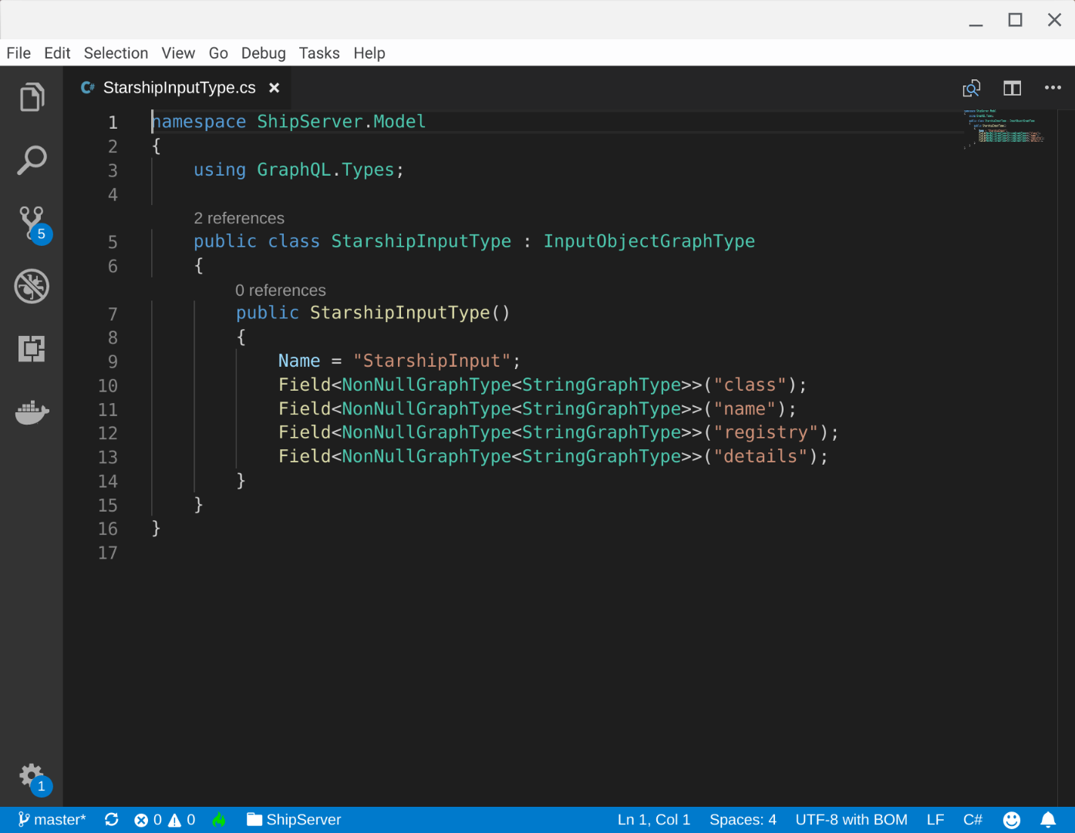

Slide 47
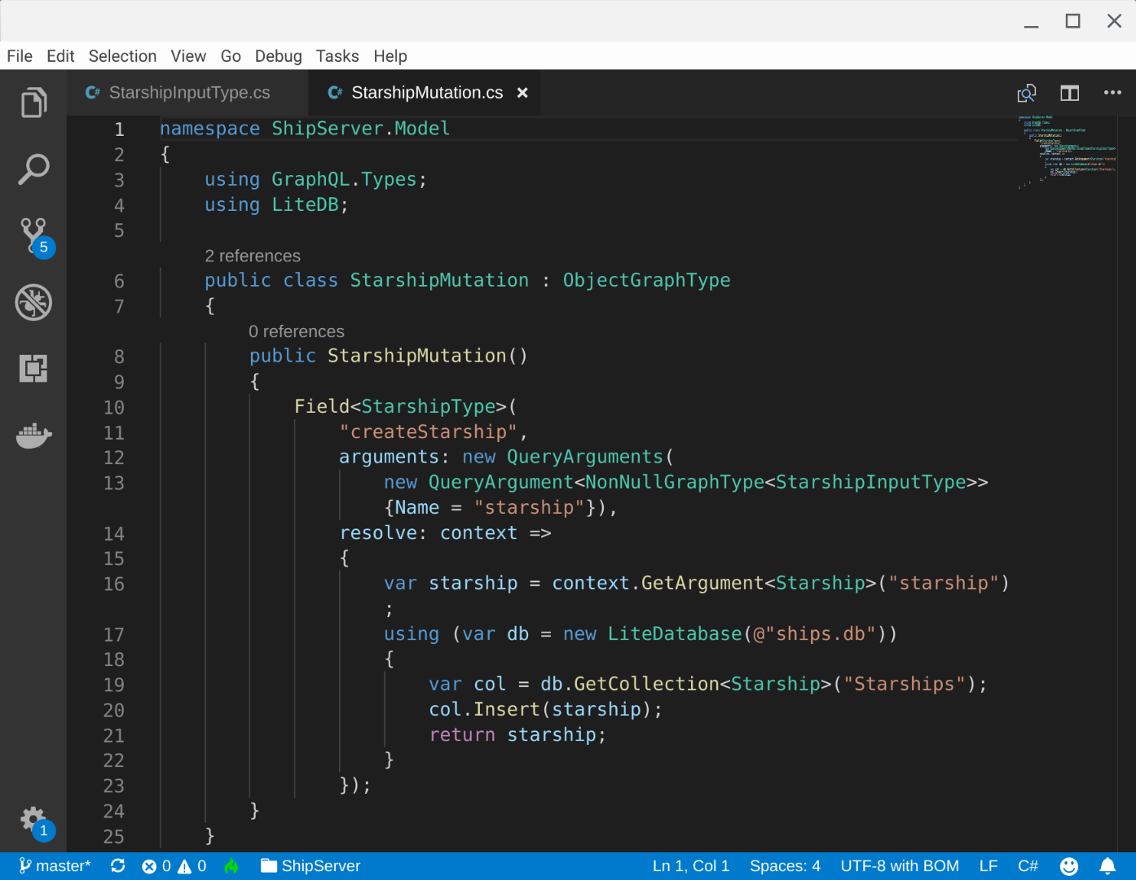

Slide 48
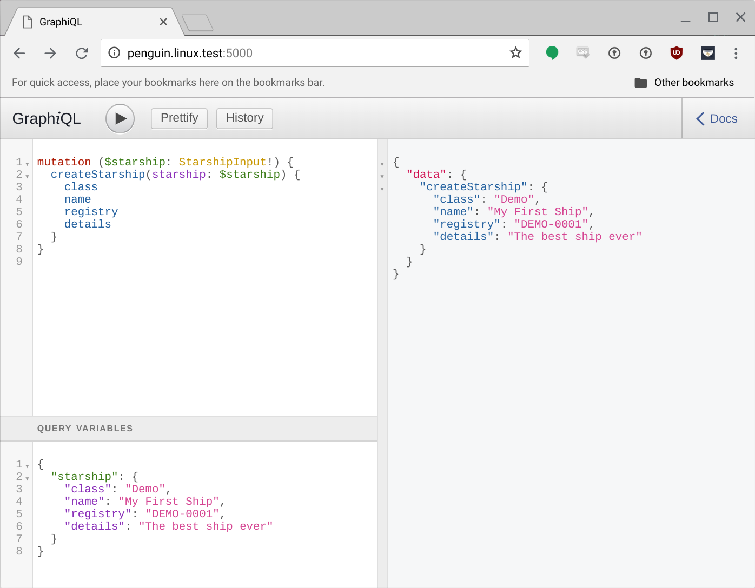

Slide 49
Great for data-centric APIs

Slide 50
Great for data-centric APIs
Allows good control over data access

Slide 51
Great for data-centric APIs
Allows good control over data access
Works well for the web

Slide 52
Great for data-centric APIs
Allows good control over data access
Works well for the web
Has some nice tooling

Slide 53
Links:
https://graphql.org/
https://github.com/graphql-dotnet/graphql-dotnet
https://github.com/graphql/graphiql
https://github.com/graphql-dotnet/graphql-client

Slide 54
Not a single standard

Slide 55
Not a single standard
A component of REST application architecture

Slide 56
Not a single standard
A component of REST application architecture
There are lots of hypermedia formats

Slide 57
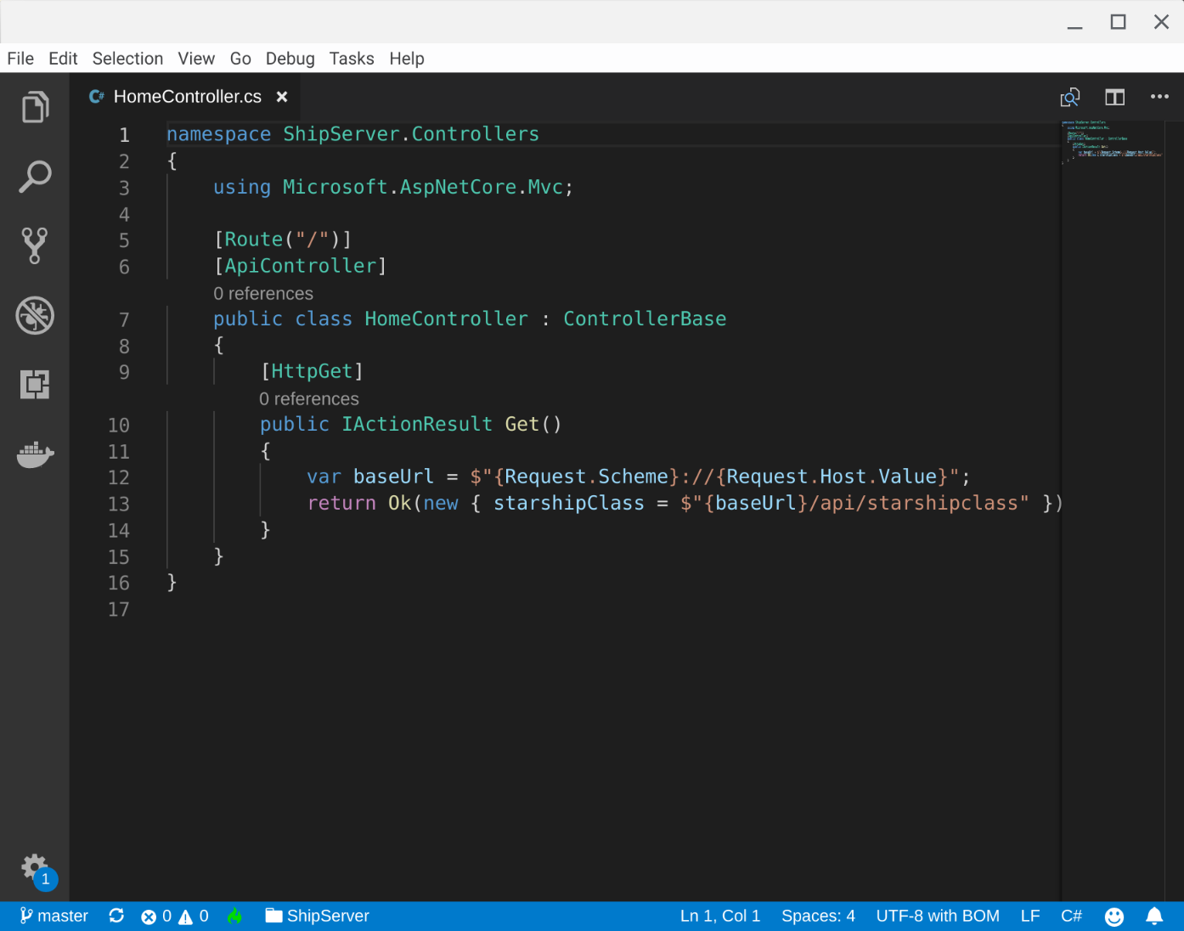

Slide 58
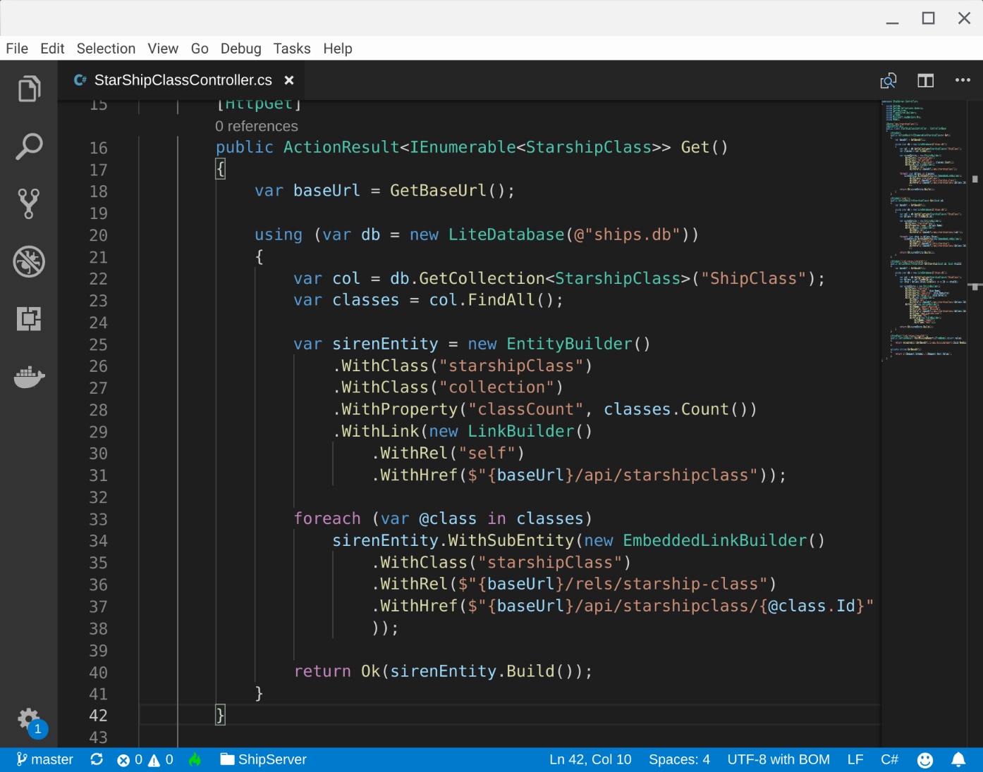

Slide 59
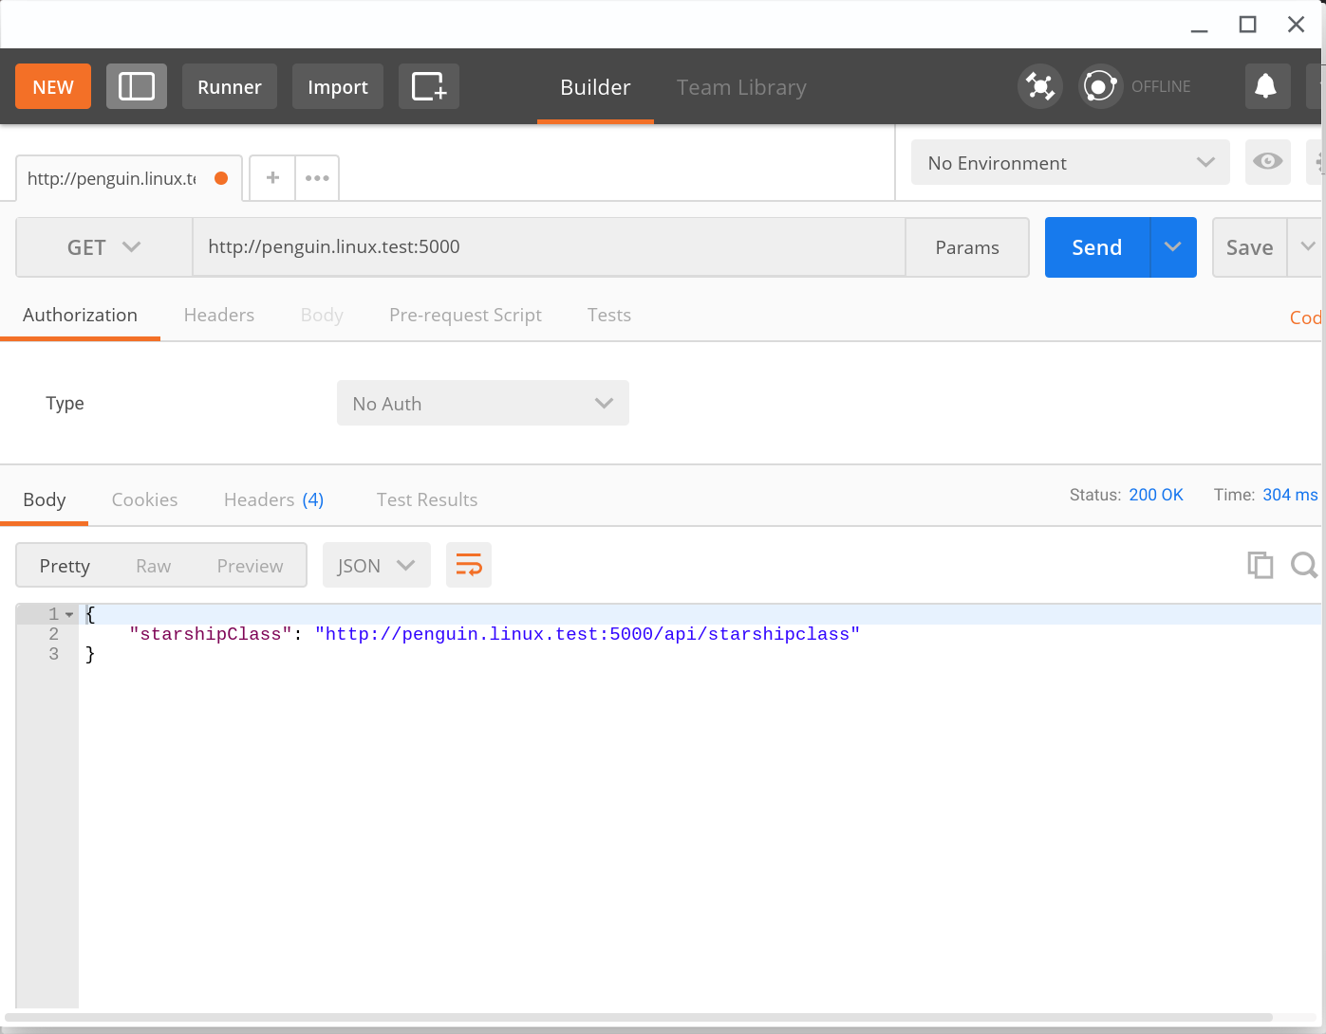

Slide 60
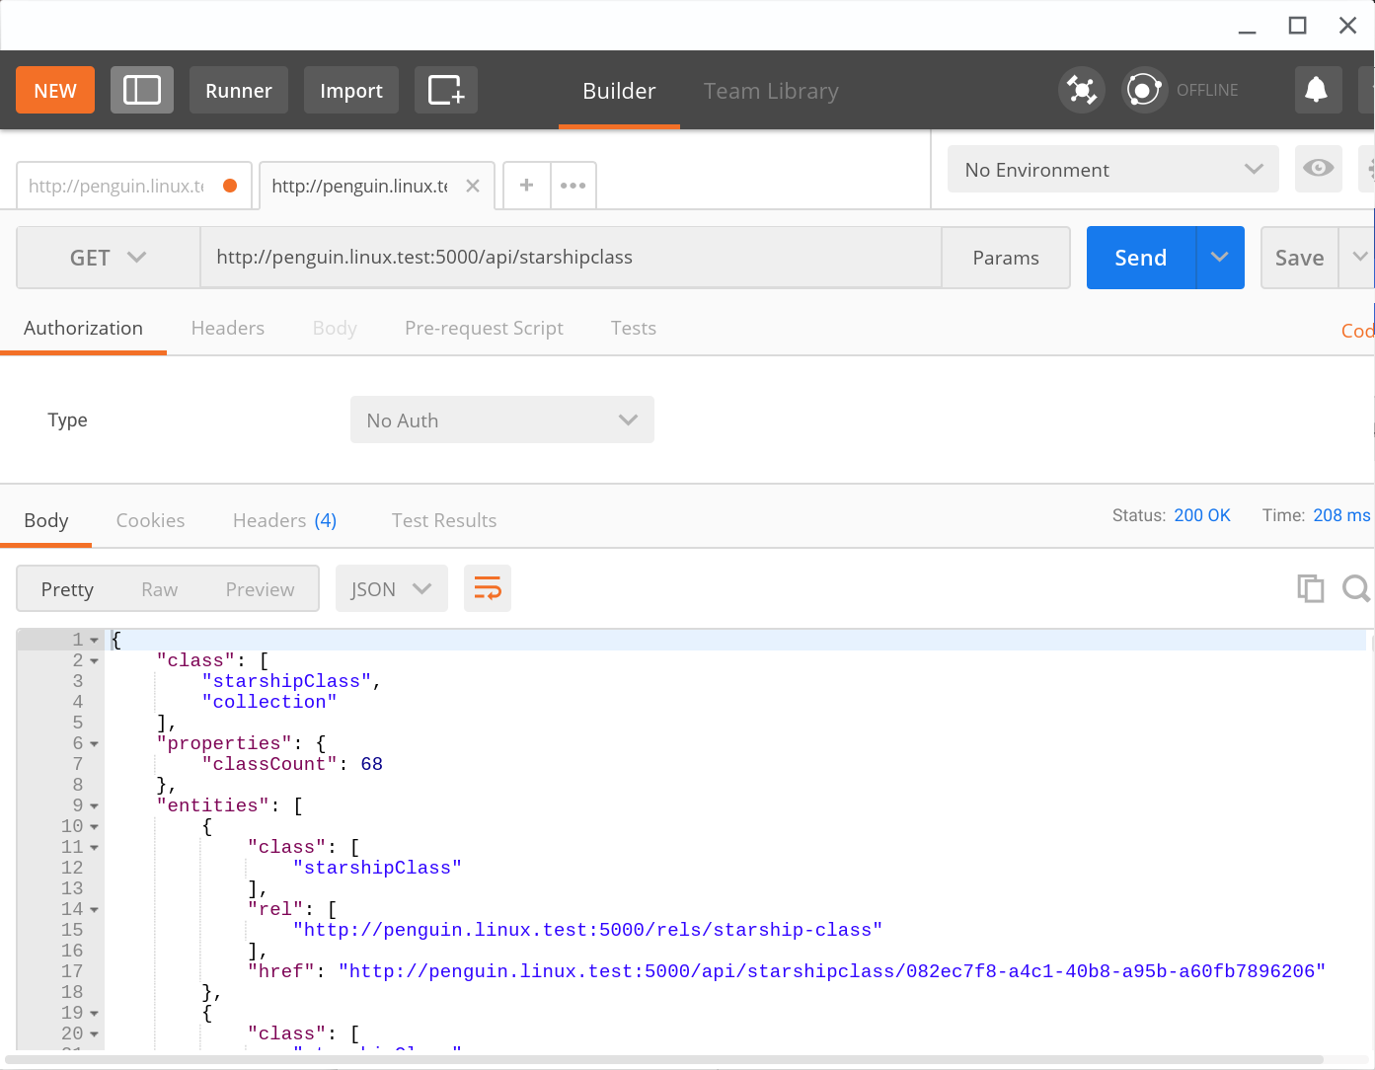

Slide 61
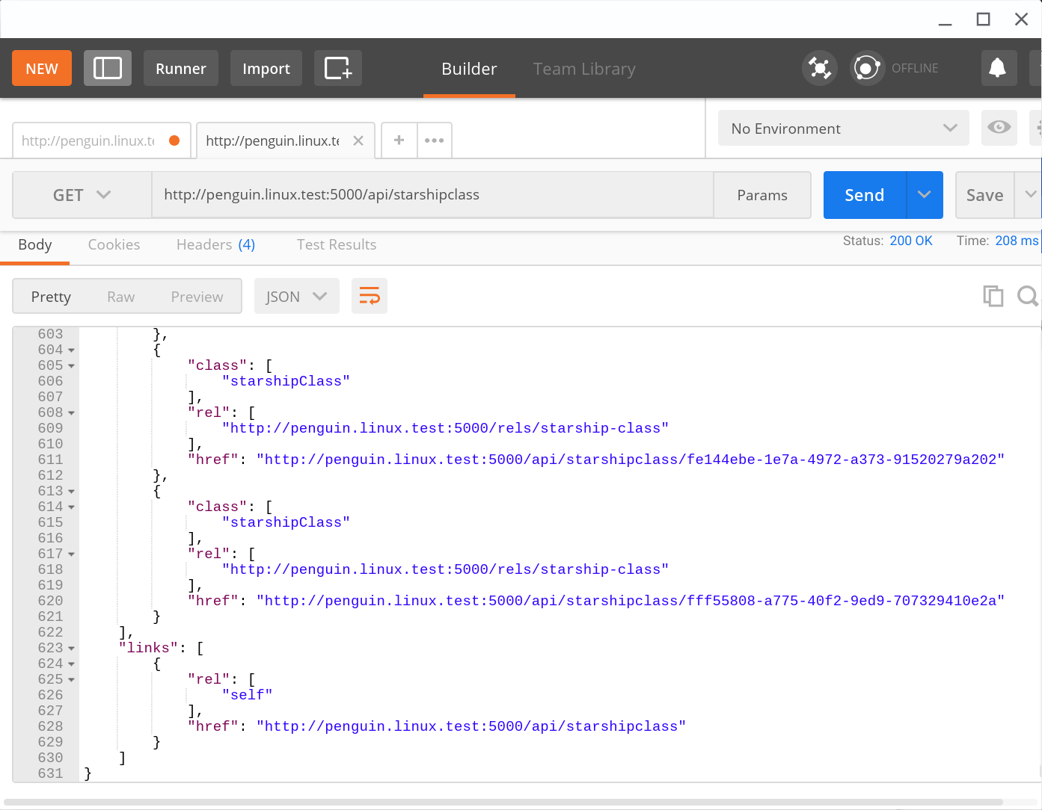

Slide 62
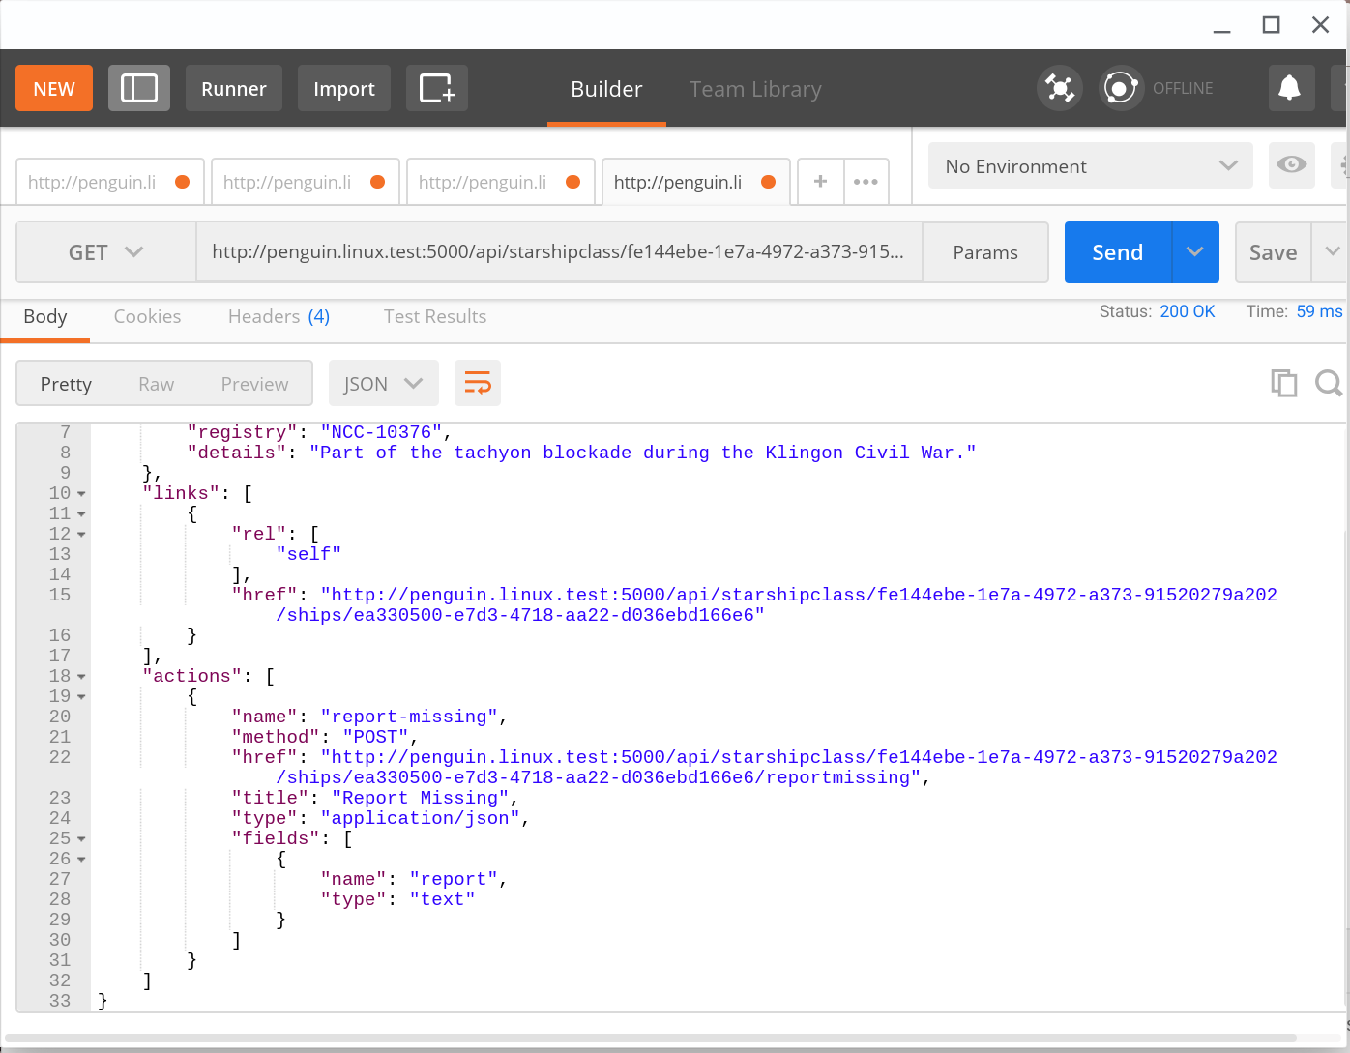

Slide 63
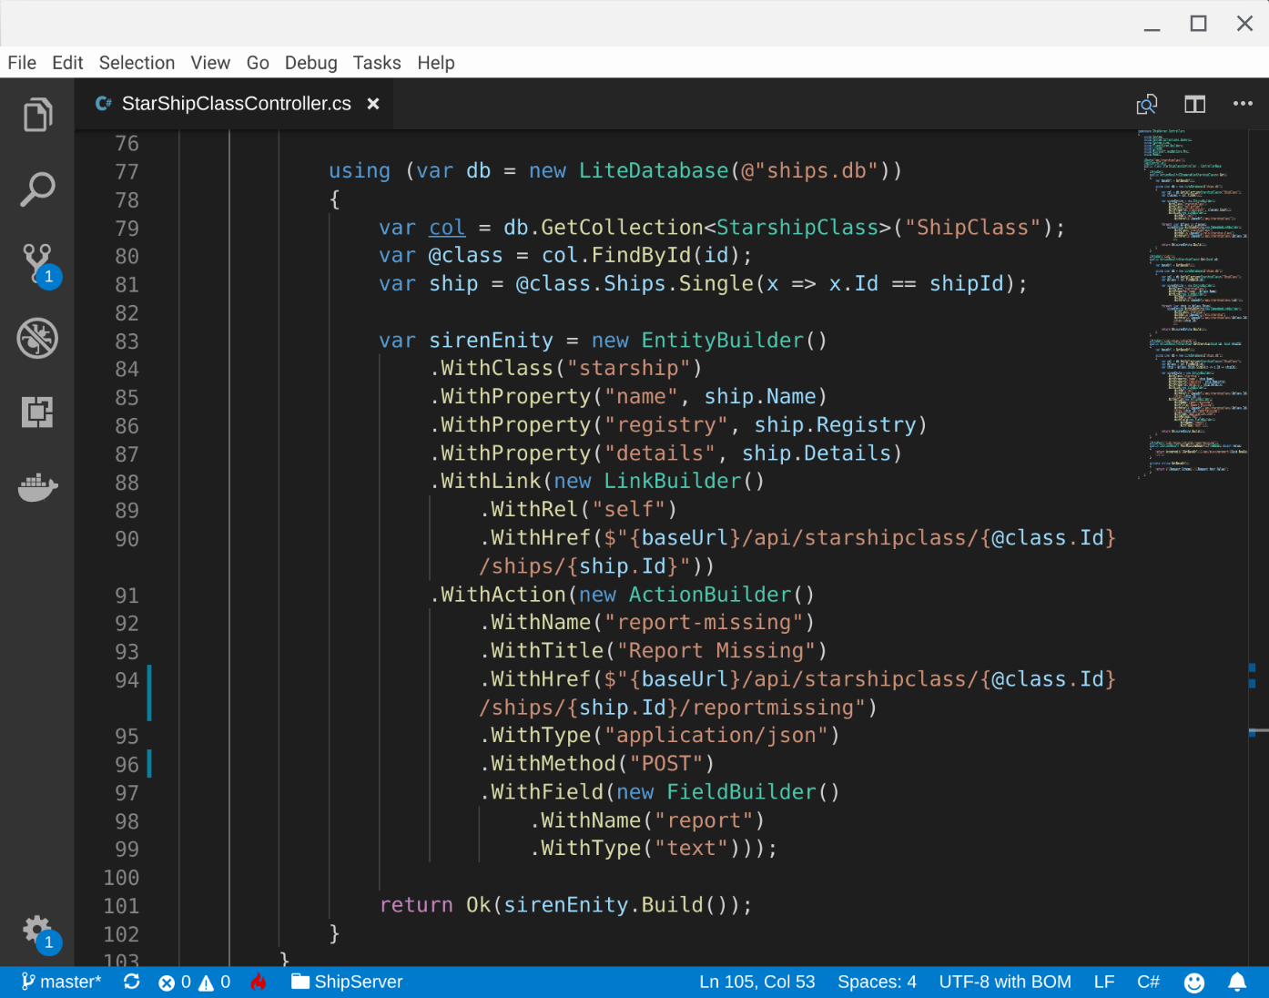

Slide 64
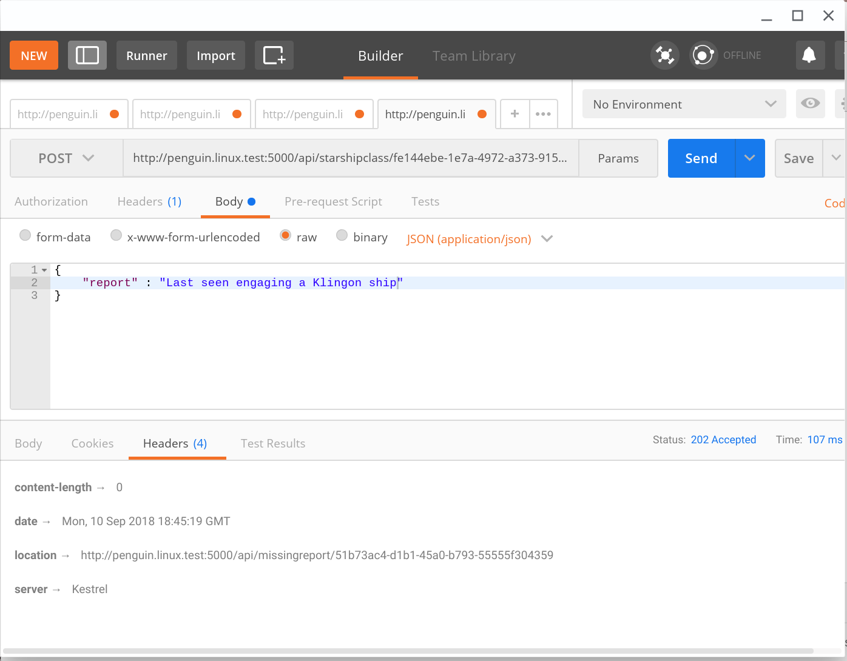

Slide 65
Well suited to smart clients

Slide 66
Well suited to smart clients
It’s about more than data

Slide 67
Well suited to smart clients
It’s about more than data
Well suited for the web

Slide 68
Well suited to smart clients
It’s about more than data
Well suited for the web
Great tooling

Slide 69
Links:
https://github.com/kevinswiber/siren
https://github.com/agabani/FluentSiren
https://github.com/visualeyes/halcyon
https://github.com/nbarbettini/BeautifulRestApi

Slide 70
So what should I use?

Slide 71
Questions?
Code & Slides available: https://github.com/welshdave/CoreAPIs
This presentation will soon be available on the conference website at the following link... https://skillsmatter.com/conferences/10107-prognet-london-2018#skillscasts
@welshdave
dave@dllewis.org

